Slide 1
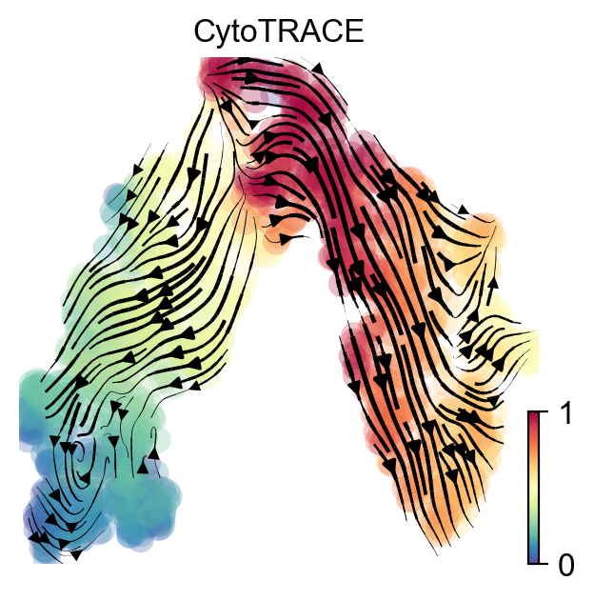
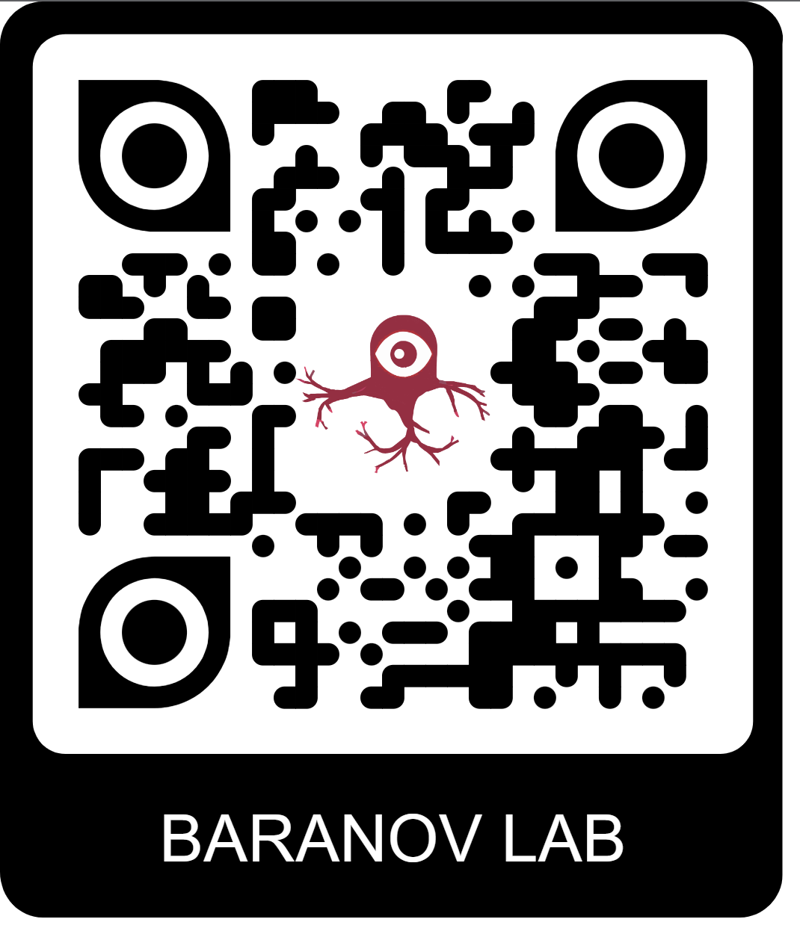

Belgrade Bioinformatics Workshop 2023
Emil Kriukov
Petr Baranov Lab
Day 1

Slide 2

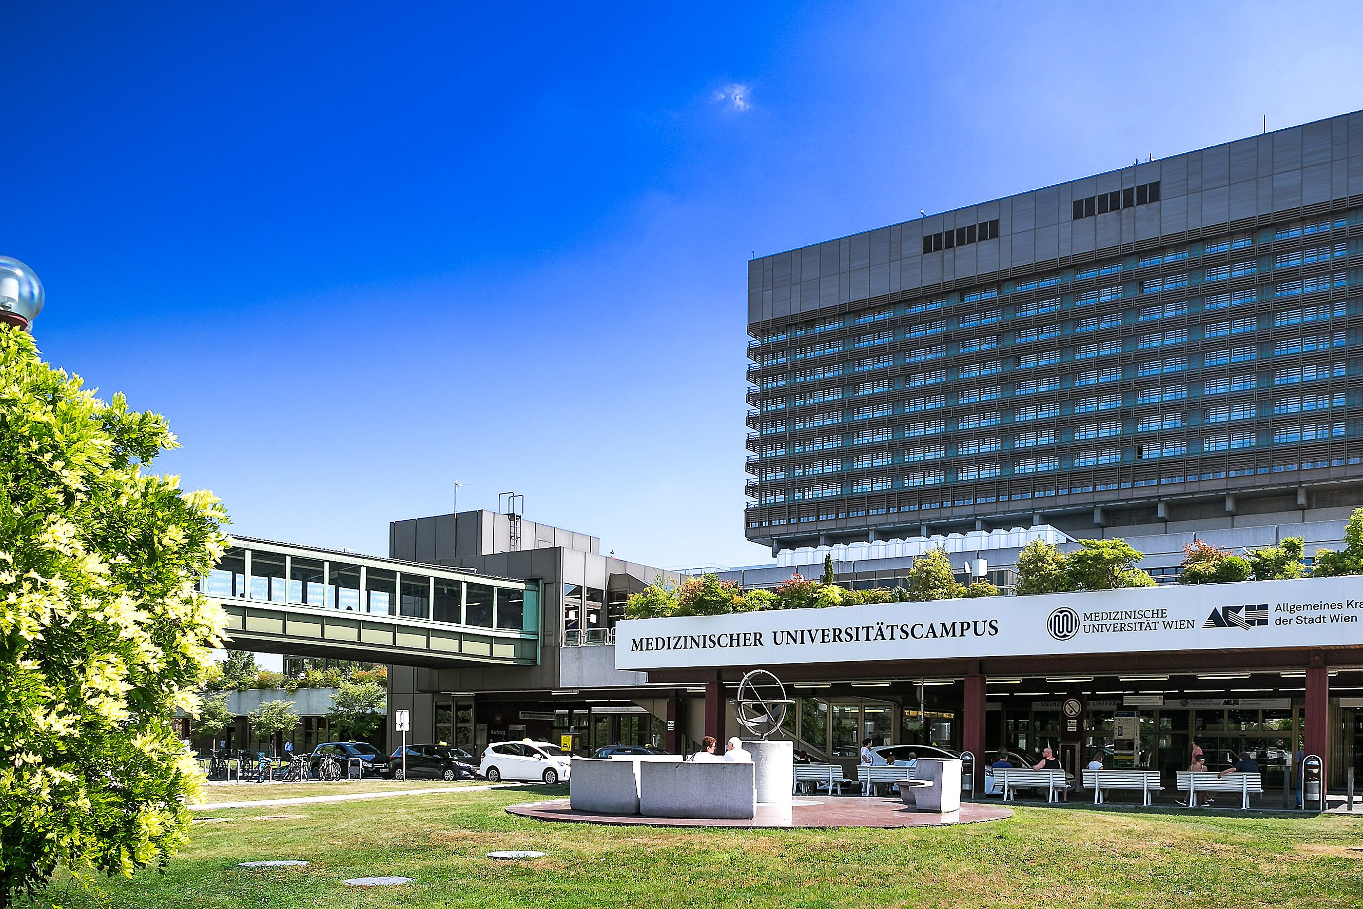
About me

Slide 3
Agenda
1. Sequencing technology.
2. 10X platform – methods and approaches.
3. R- and Python- dependent tools: Seurat, scanpy. PBMC dataset practice in R.
Week 2. How to find the relevant dataset: publicly available tools, consortiums, platforms. Databases for
the key sequencing methods.
Week 3. Data integration: theory, examples, and possible approaches for multiple tissues, species, and
conditions.
Week 4. Cell-cell interactions with the single-cell resolution.
Week 5. What else could you find in the single-cell methods?

Slide 4
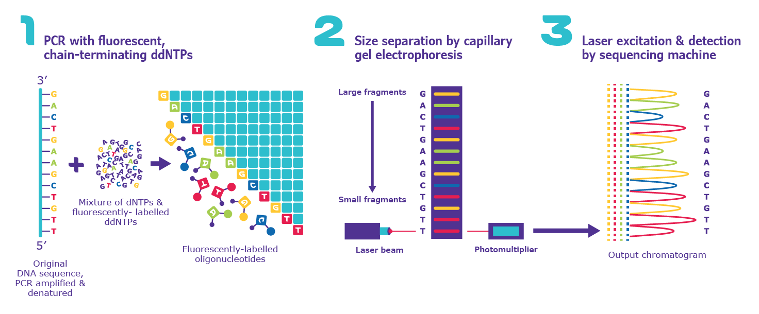
What is sequencing?

Slide 5
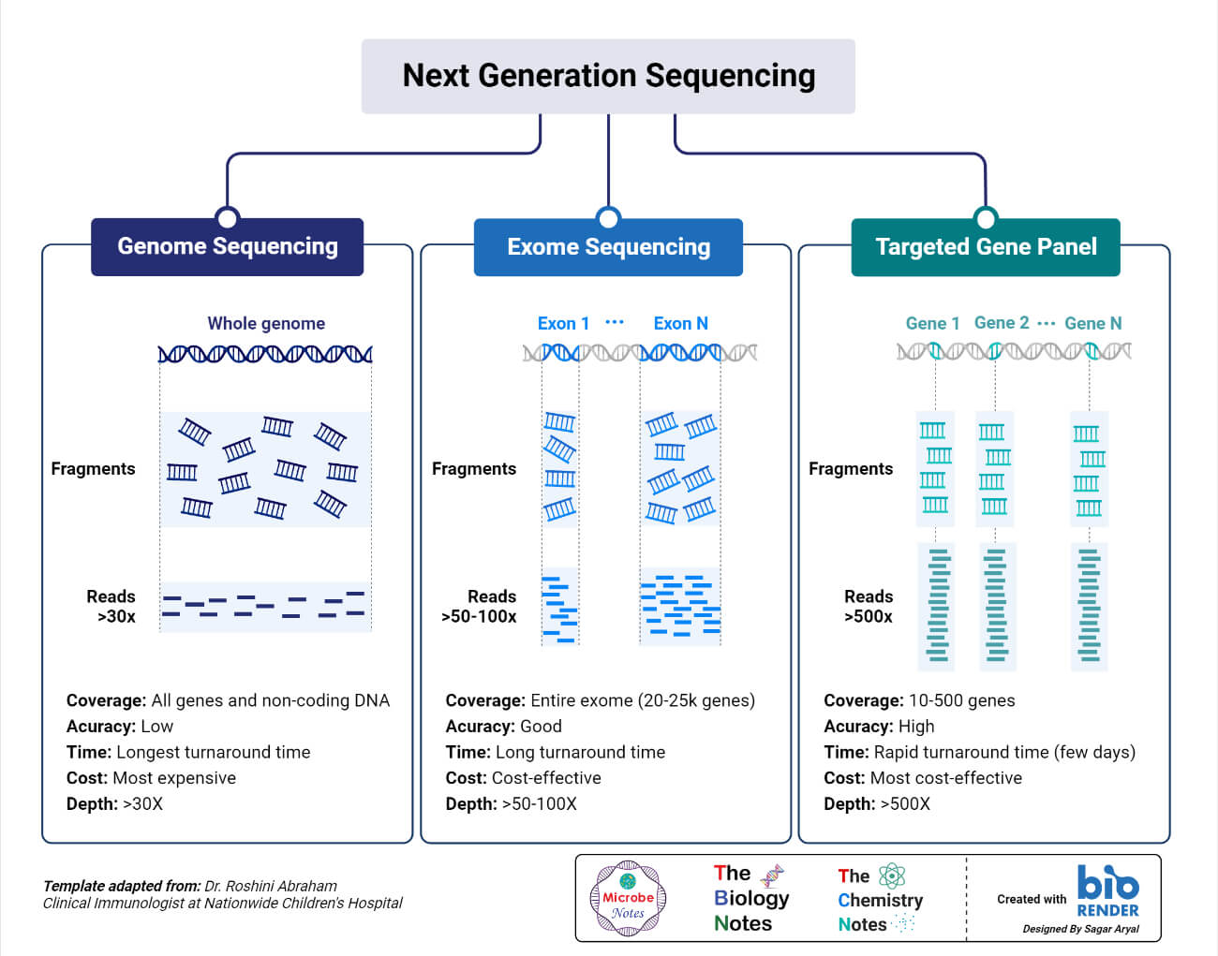
Sequencing methods

Slide 6
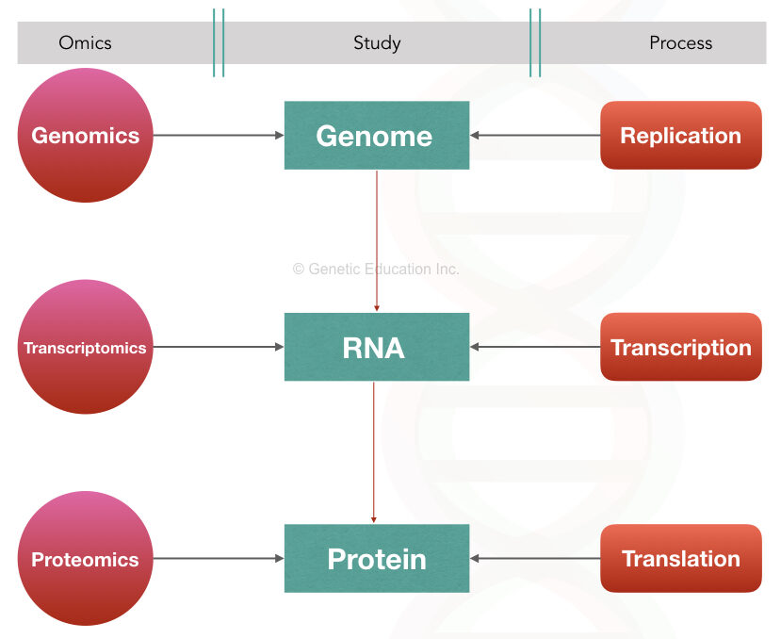
Sequencing targets

Slide 7
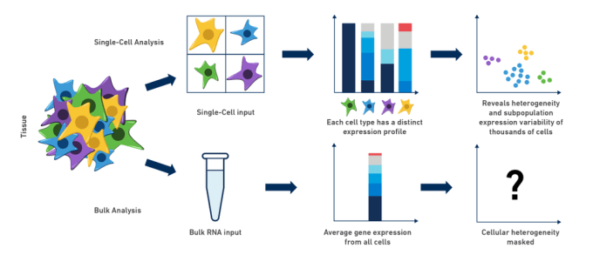
Sequencing technologies

Slide 8
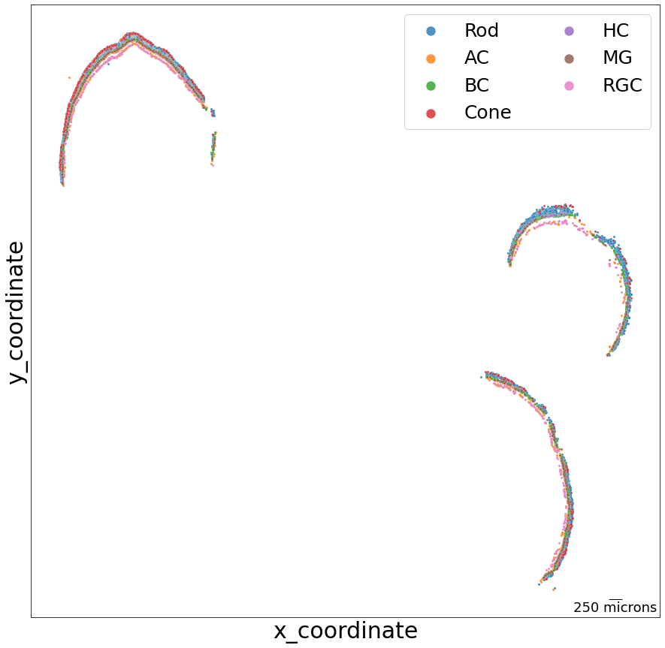
Spatial sequencing

Slide 9
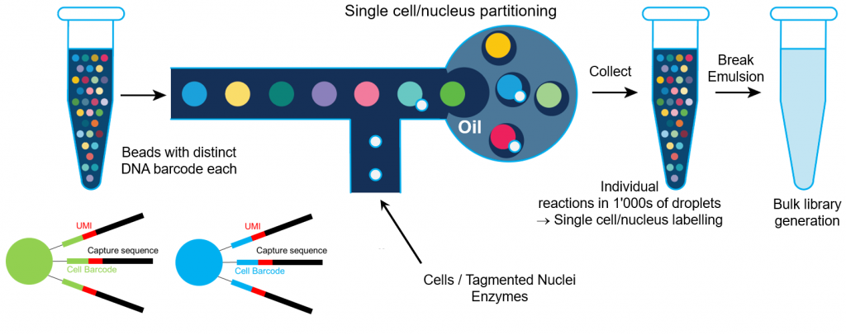
10X platform for scRNAseq

Slide 10
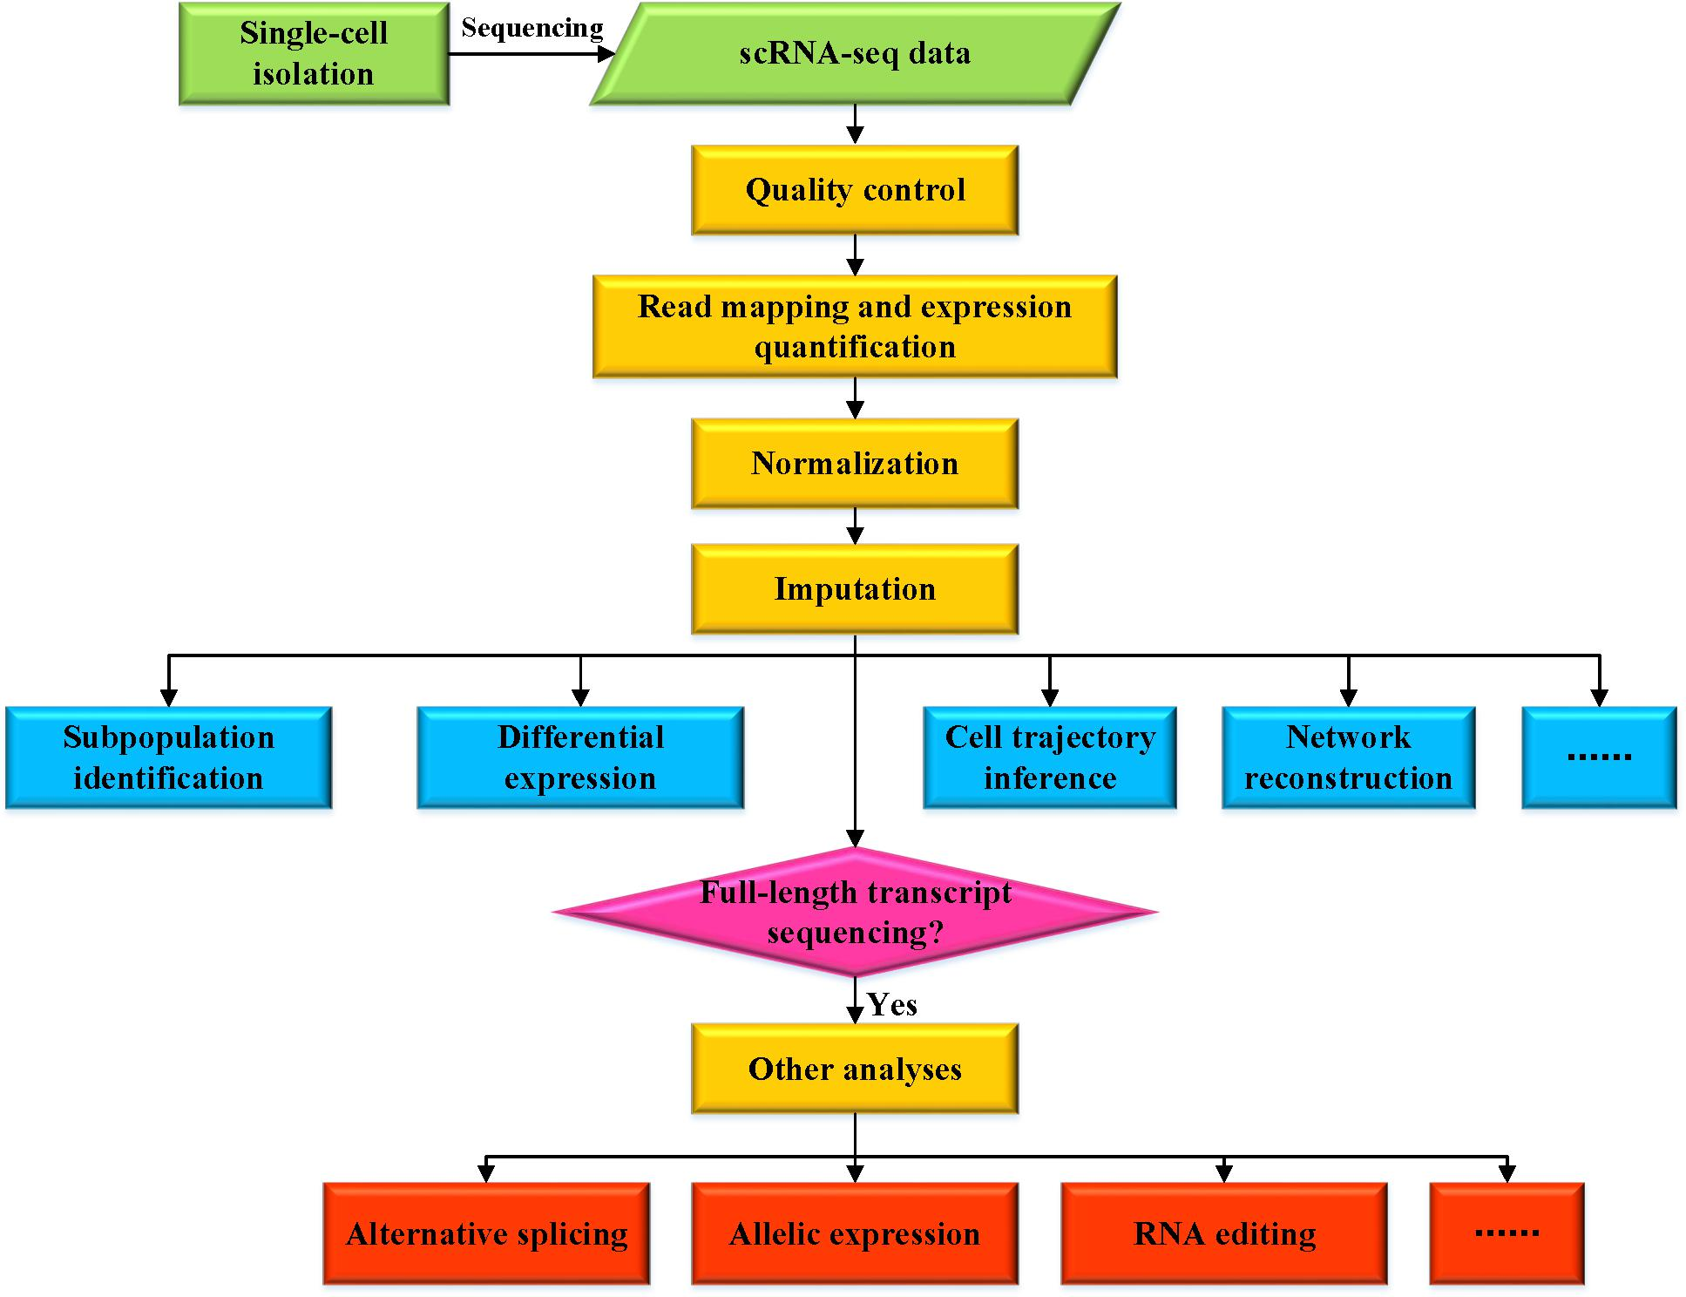
Data analysis pipeline

Slide 11
Seurat and Scanpy (to be updated on the next days)
Feature | Seurat | Scanpy
Language | R | Python
Technology | sn/scRNAseq V5 - spatial | sn/scRNAseq
Efficiency | BPCells – up to millions of cells | ?

Slide 12
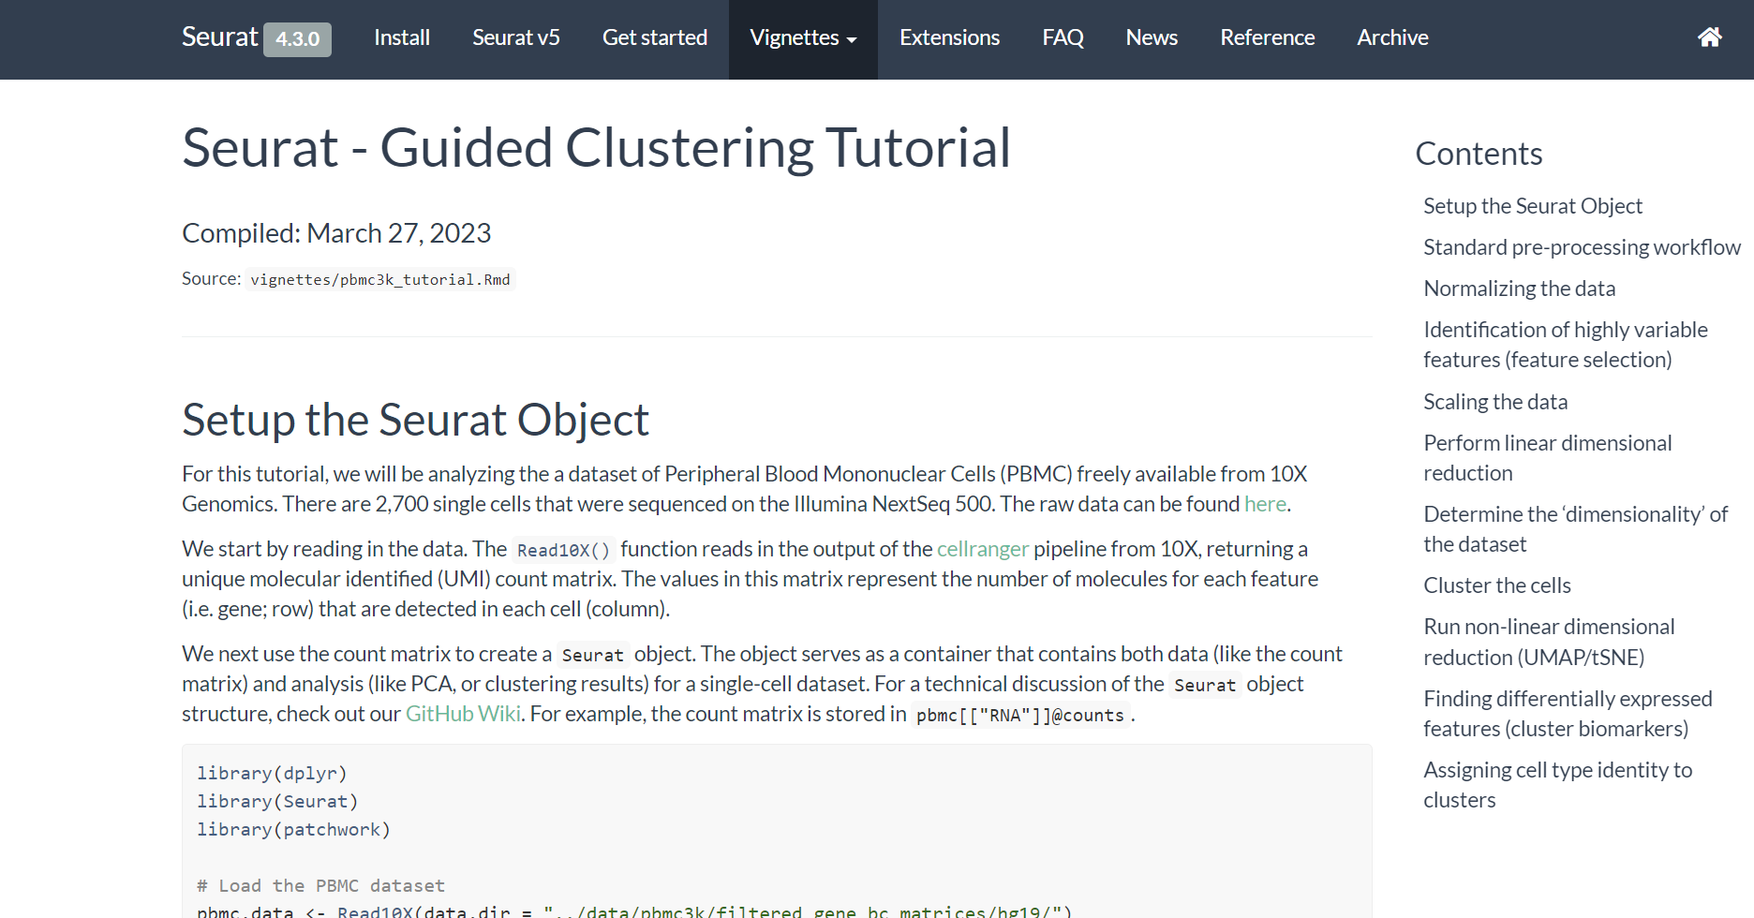
Practice. PBMC data analysis

Slide 13
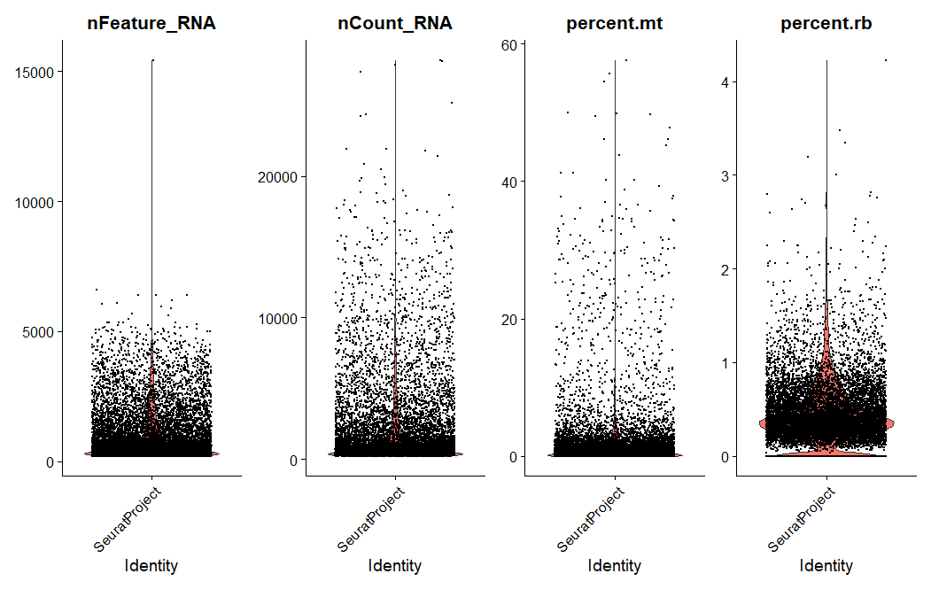
Thresholding practice

Slide 14
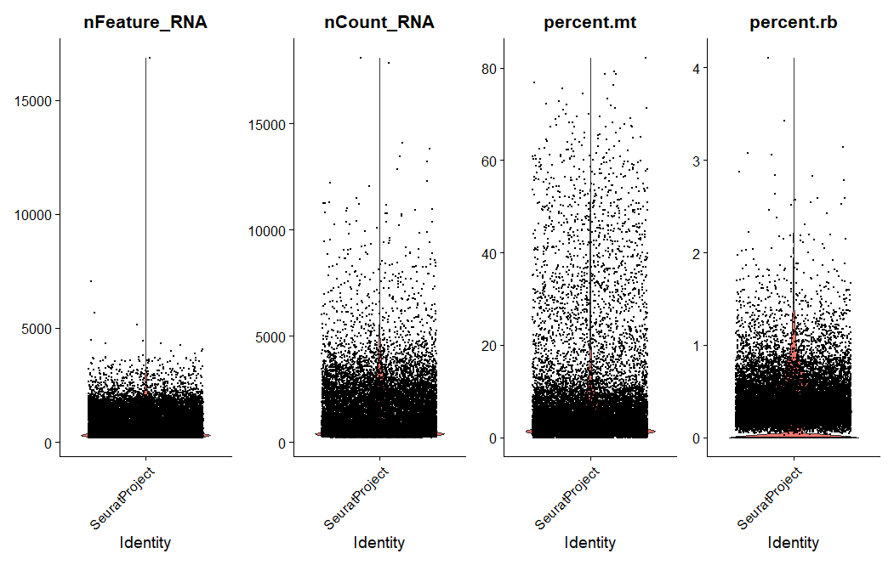
Thresholding practice

Slide 15
Embedding examples

Slide 16
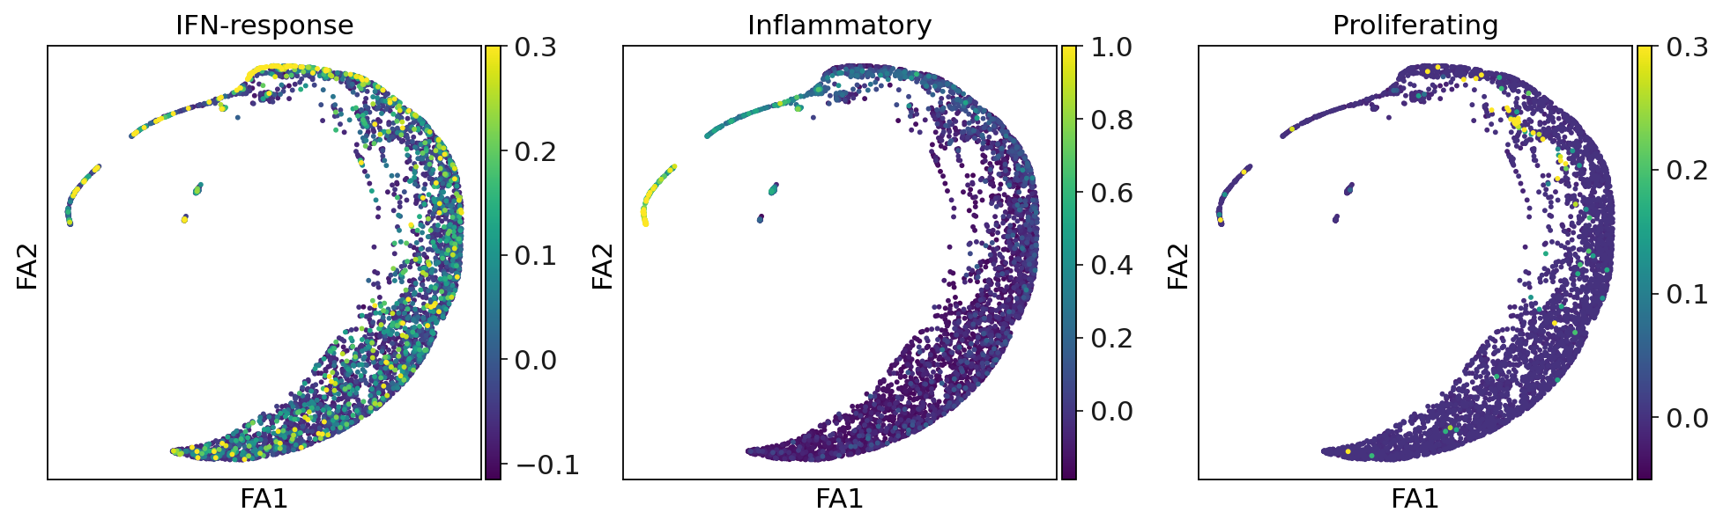
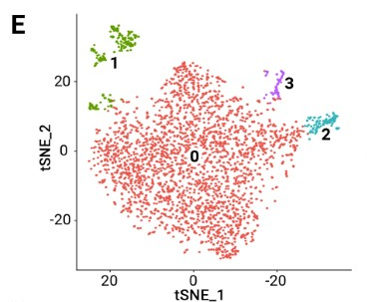
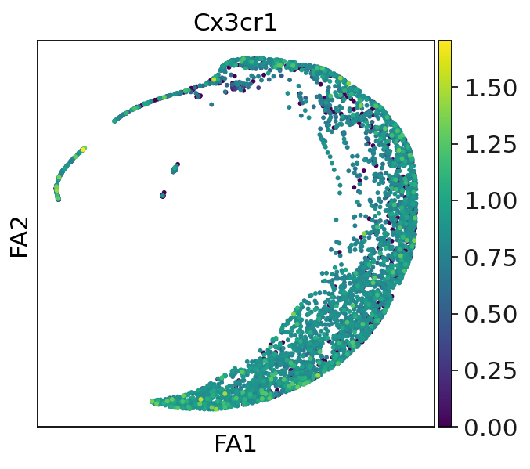
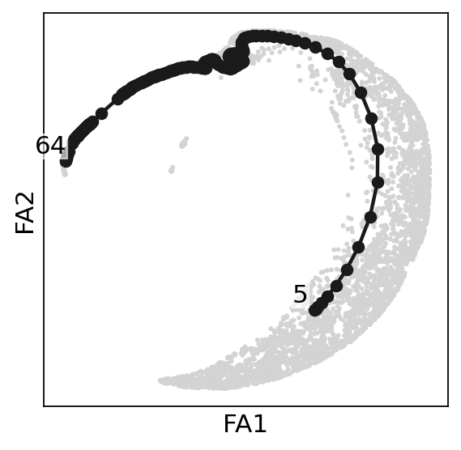
After:
BIOLOGICAL RELEVANCE OF FORCEATLAS2 –
MICROGLIA
Before:
Data: Chen Lab, published, Cell Reports, 2023
Analysis: Kriukov E.

Slide 17
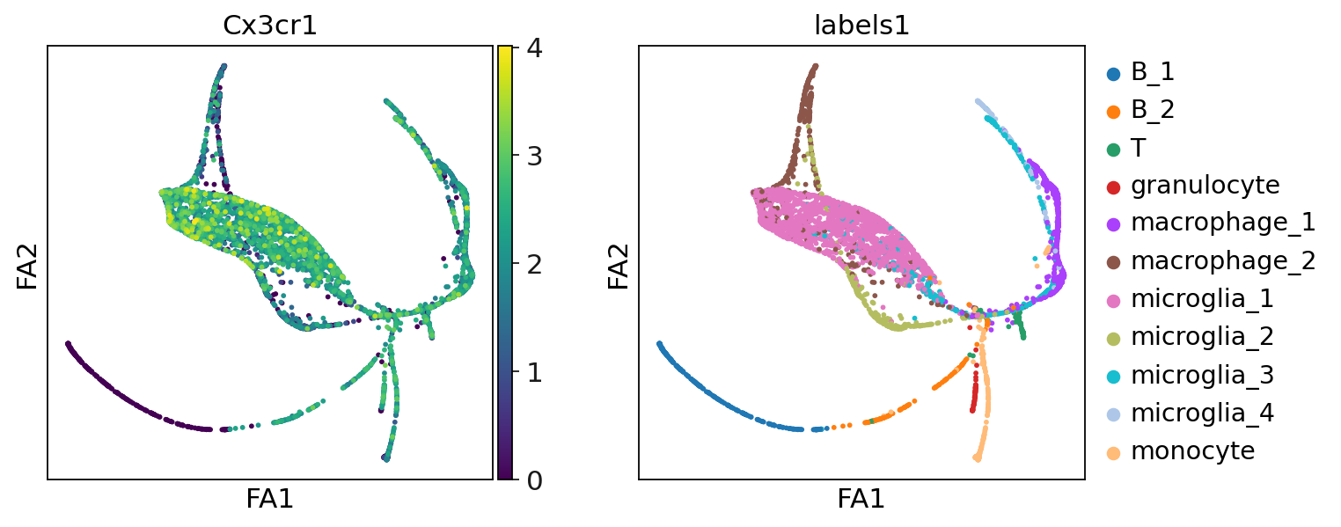

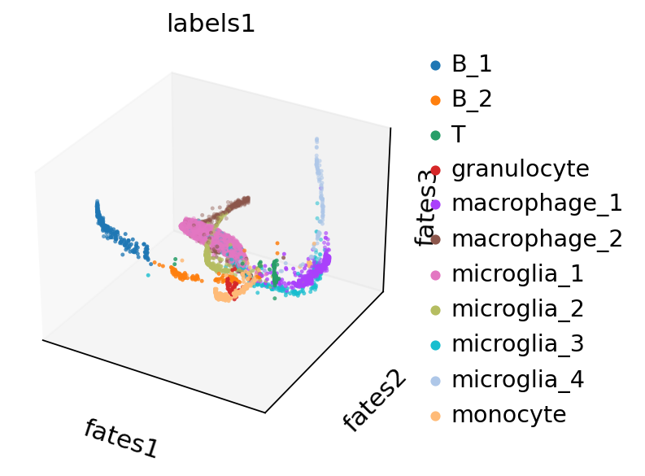
HOW TO IMPROVE OUR UNDERSTANDING OF SC DATA?
Data: Sun Lab, unpublished
Analysis: Kriukov E.

Slide 18
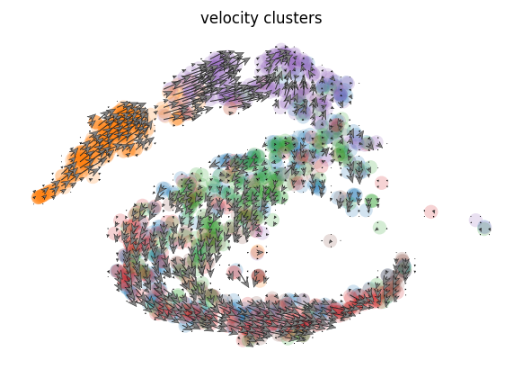
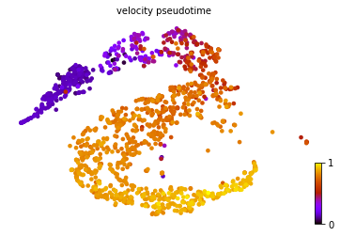
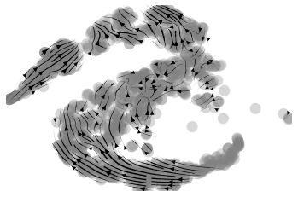
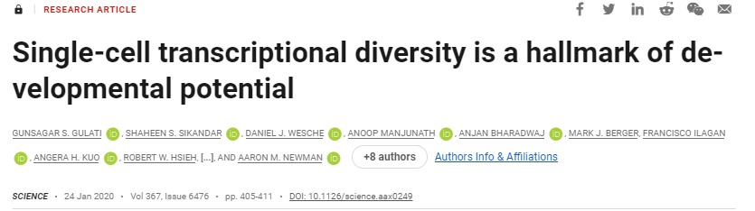
RNA VELOCITY + CYTOTRACE
Data: Adameyko Lab, unpublished
Chagin Lab, unpublished
Analysis: Kriukov E., Faure L., Zhou B., Chu TL.

Slide 19
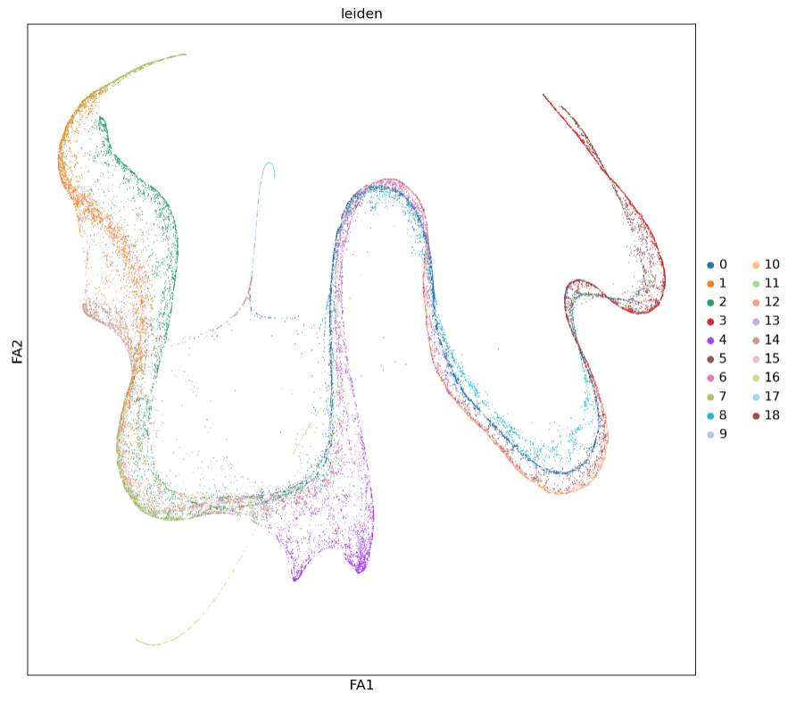
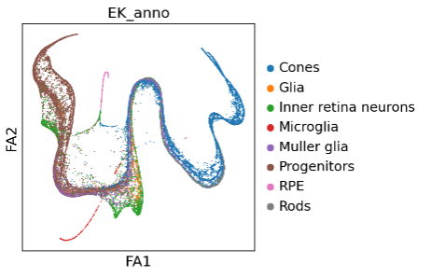
Studying donor cell fate after transplantation
GCL
INL
ONL
// Data: Raghavi Sudharsan; William Beltran (unpublished)
Analysis: Kriukov E.

Slide 20
Seurat vs Scanpy

Slide 21
Homework
PBMC dataset
Edit your code (see GitHub reference)
Change the settings (select 3+) and reanalyze the dataset
Upload your code to the GitHub repo before 7 PM October 15 – R Markdown required
The most remarkable homework results will be discussed on Day 2
Literature, references, links, packages – wait for the email

